Slide 1
FLOWCHARTS
From the previous lecture, we learnt that there are many ways of specifying an algorithm and these include pseudocodes and flowcharts.
We discussed pseudocode in the previous lecture so this lecture will focus on flowcharts.

Slide 2
METHODS OF SPECIFYING ALGORITHM
Flowchart - a traditional graphical tool with standardized symbols that shows the sequence of steps in an algorithm.

Slide 3
Flowcharts
Flowcharts graphically depict the logical steps to carry out a task and show how the steps relate to each other.

Slide 4
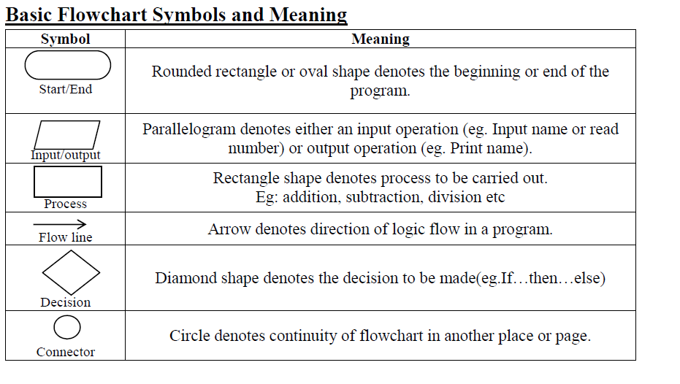

Slide 5
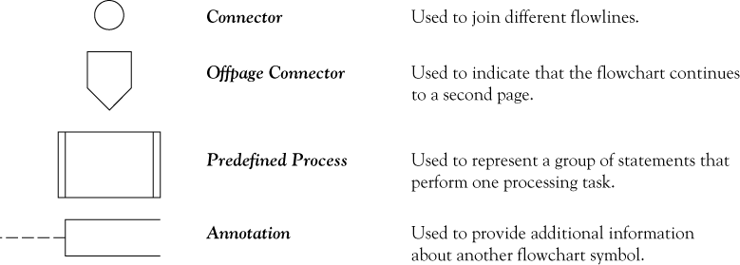
Flowchart symbols continued

Slide 6
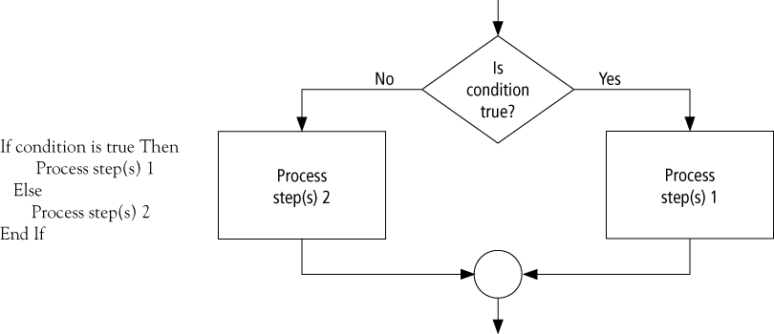
Decision flow chart

Slide 7
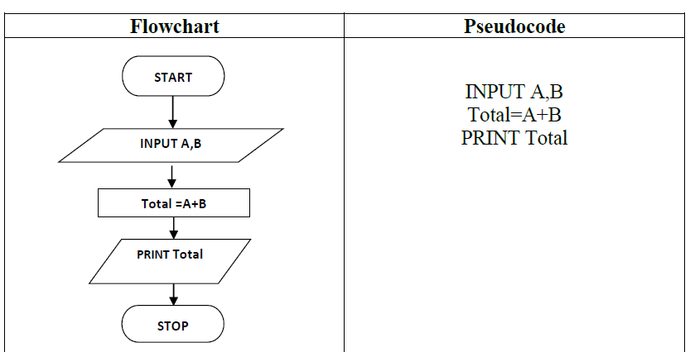
Flowchart – Example 1
Write an algorithm, using pseudocode and a flowchart to inputs two numbers and find sum of these numbers.

Slide 8
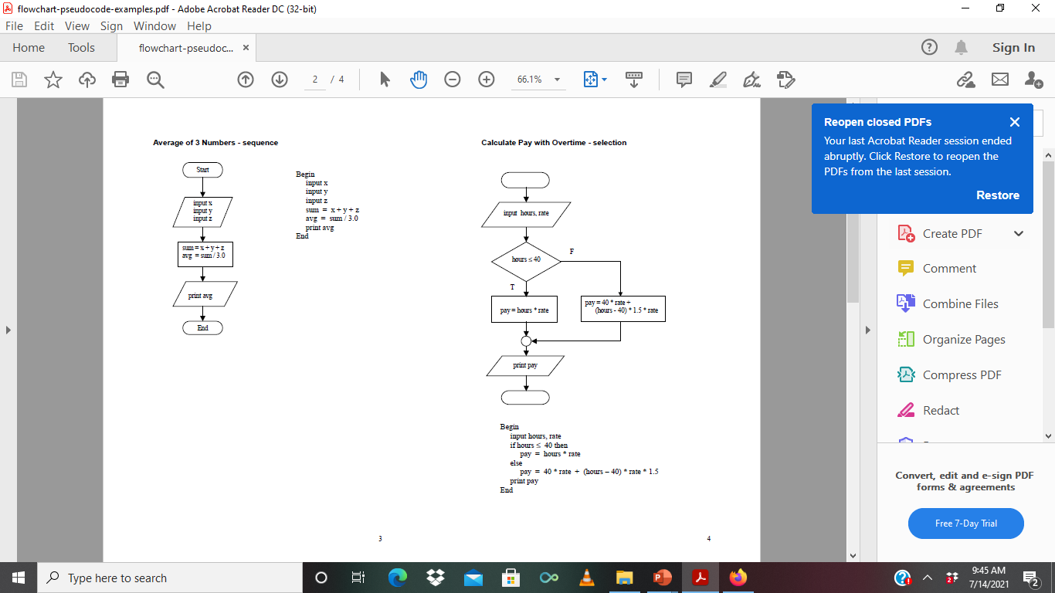
Flowchart – Example 2
Write an algorithm using flowchart to find the average of three numbers

Slide 9
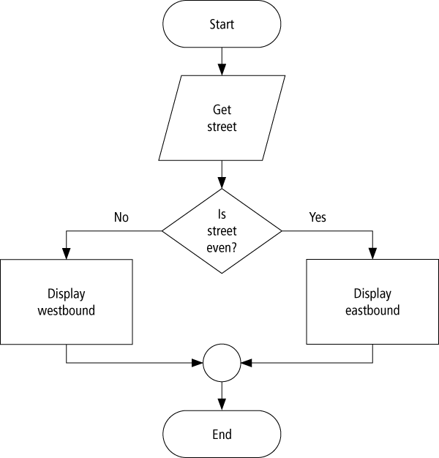
Flowchart ----- Example 3
Program: Determine the direction of a numbered NYC street
Get street
  If street is even Then
  Display Eastbound
Else
Display Westbound
End If
Flowchart for the program segment

Slide 10
Flowchart – Exercise 1
Write an algorithm using pseudocode and flowchart to determine a student’s final grade and indicate he or she passed or failed. The final grade is calculated as the average of four marks. If the final grade is below 40, print fail else print pass.

Slide 11
Flowchart – Exercise 2
Write an algorithm in pseudocode and draw a flowchart to convert the length in feet to centimeter.
Tip: 1 foot = 30.48cm

Slide 12
Flowchart – Exercise 3
Write an algorithm in pseudocode and draw a flowchart for a program that will read the two sides of a rectangle and calculate its area.

Slide 13
Flowchart – Exercise 4
Write an algorithm that reads two values, determines the largest value and prints the largest value with an identifying message.

